Slide 1
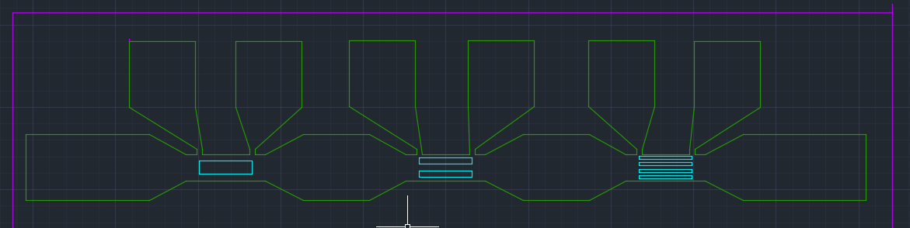
WO3196 IV-curve kinks
Measurements of Device 2 on WO3196
Light
Dark
25 C
65 C
In 0.1% H2/Ar at 1 bar
Settings
Max voltage set to 10V
0.2 s measurement time
4 point resistance measurement
V+
V-
I+
I-
Probe location are given in white
Inside green area is crystalline WO3, outside of it is amorphous WO3 on top of LAO
Inside cyan areas there is 5 nm of Pt

Slide 2
Terms
Light and dark: With and without a window in the chamber
‘Top’, ‘middle’, ‘bottom’ and ‘all’ for IV curve fits:
Top: Positive voltage part after kink
Middle: In between kinks
Bottom: Negative voltage before kink
All: Entire curve
‘Plus’ and ‘minus’ for IV curves
Plus: IV curve measured with increasing current
Minus: IV curve measured with decreasing current
Minus is measured directly after plus

Slide 3
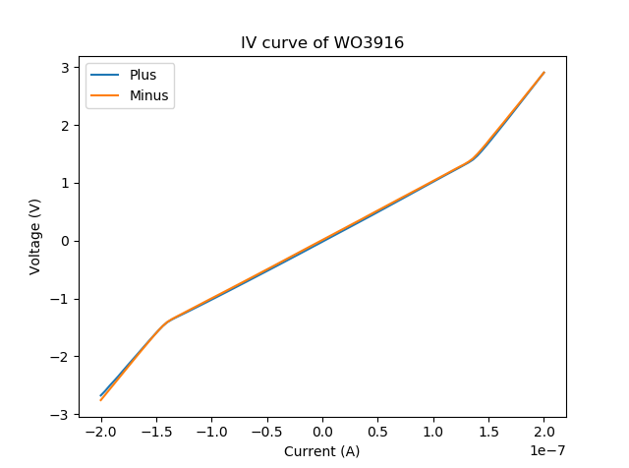
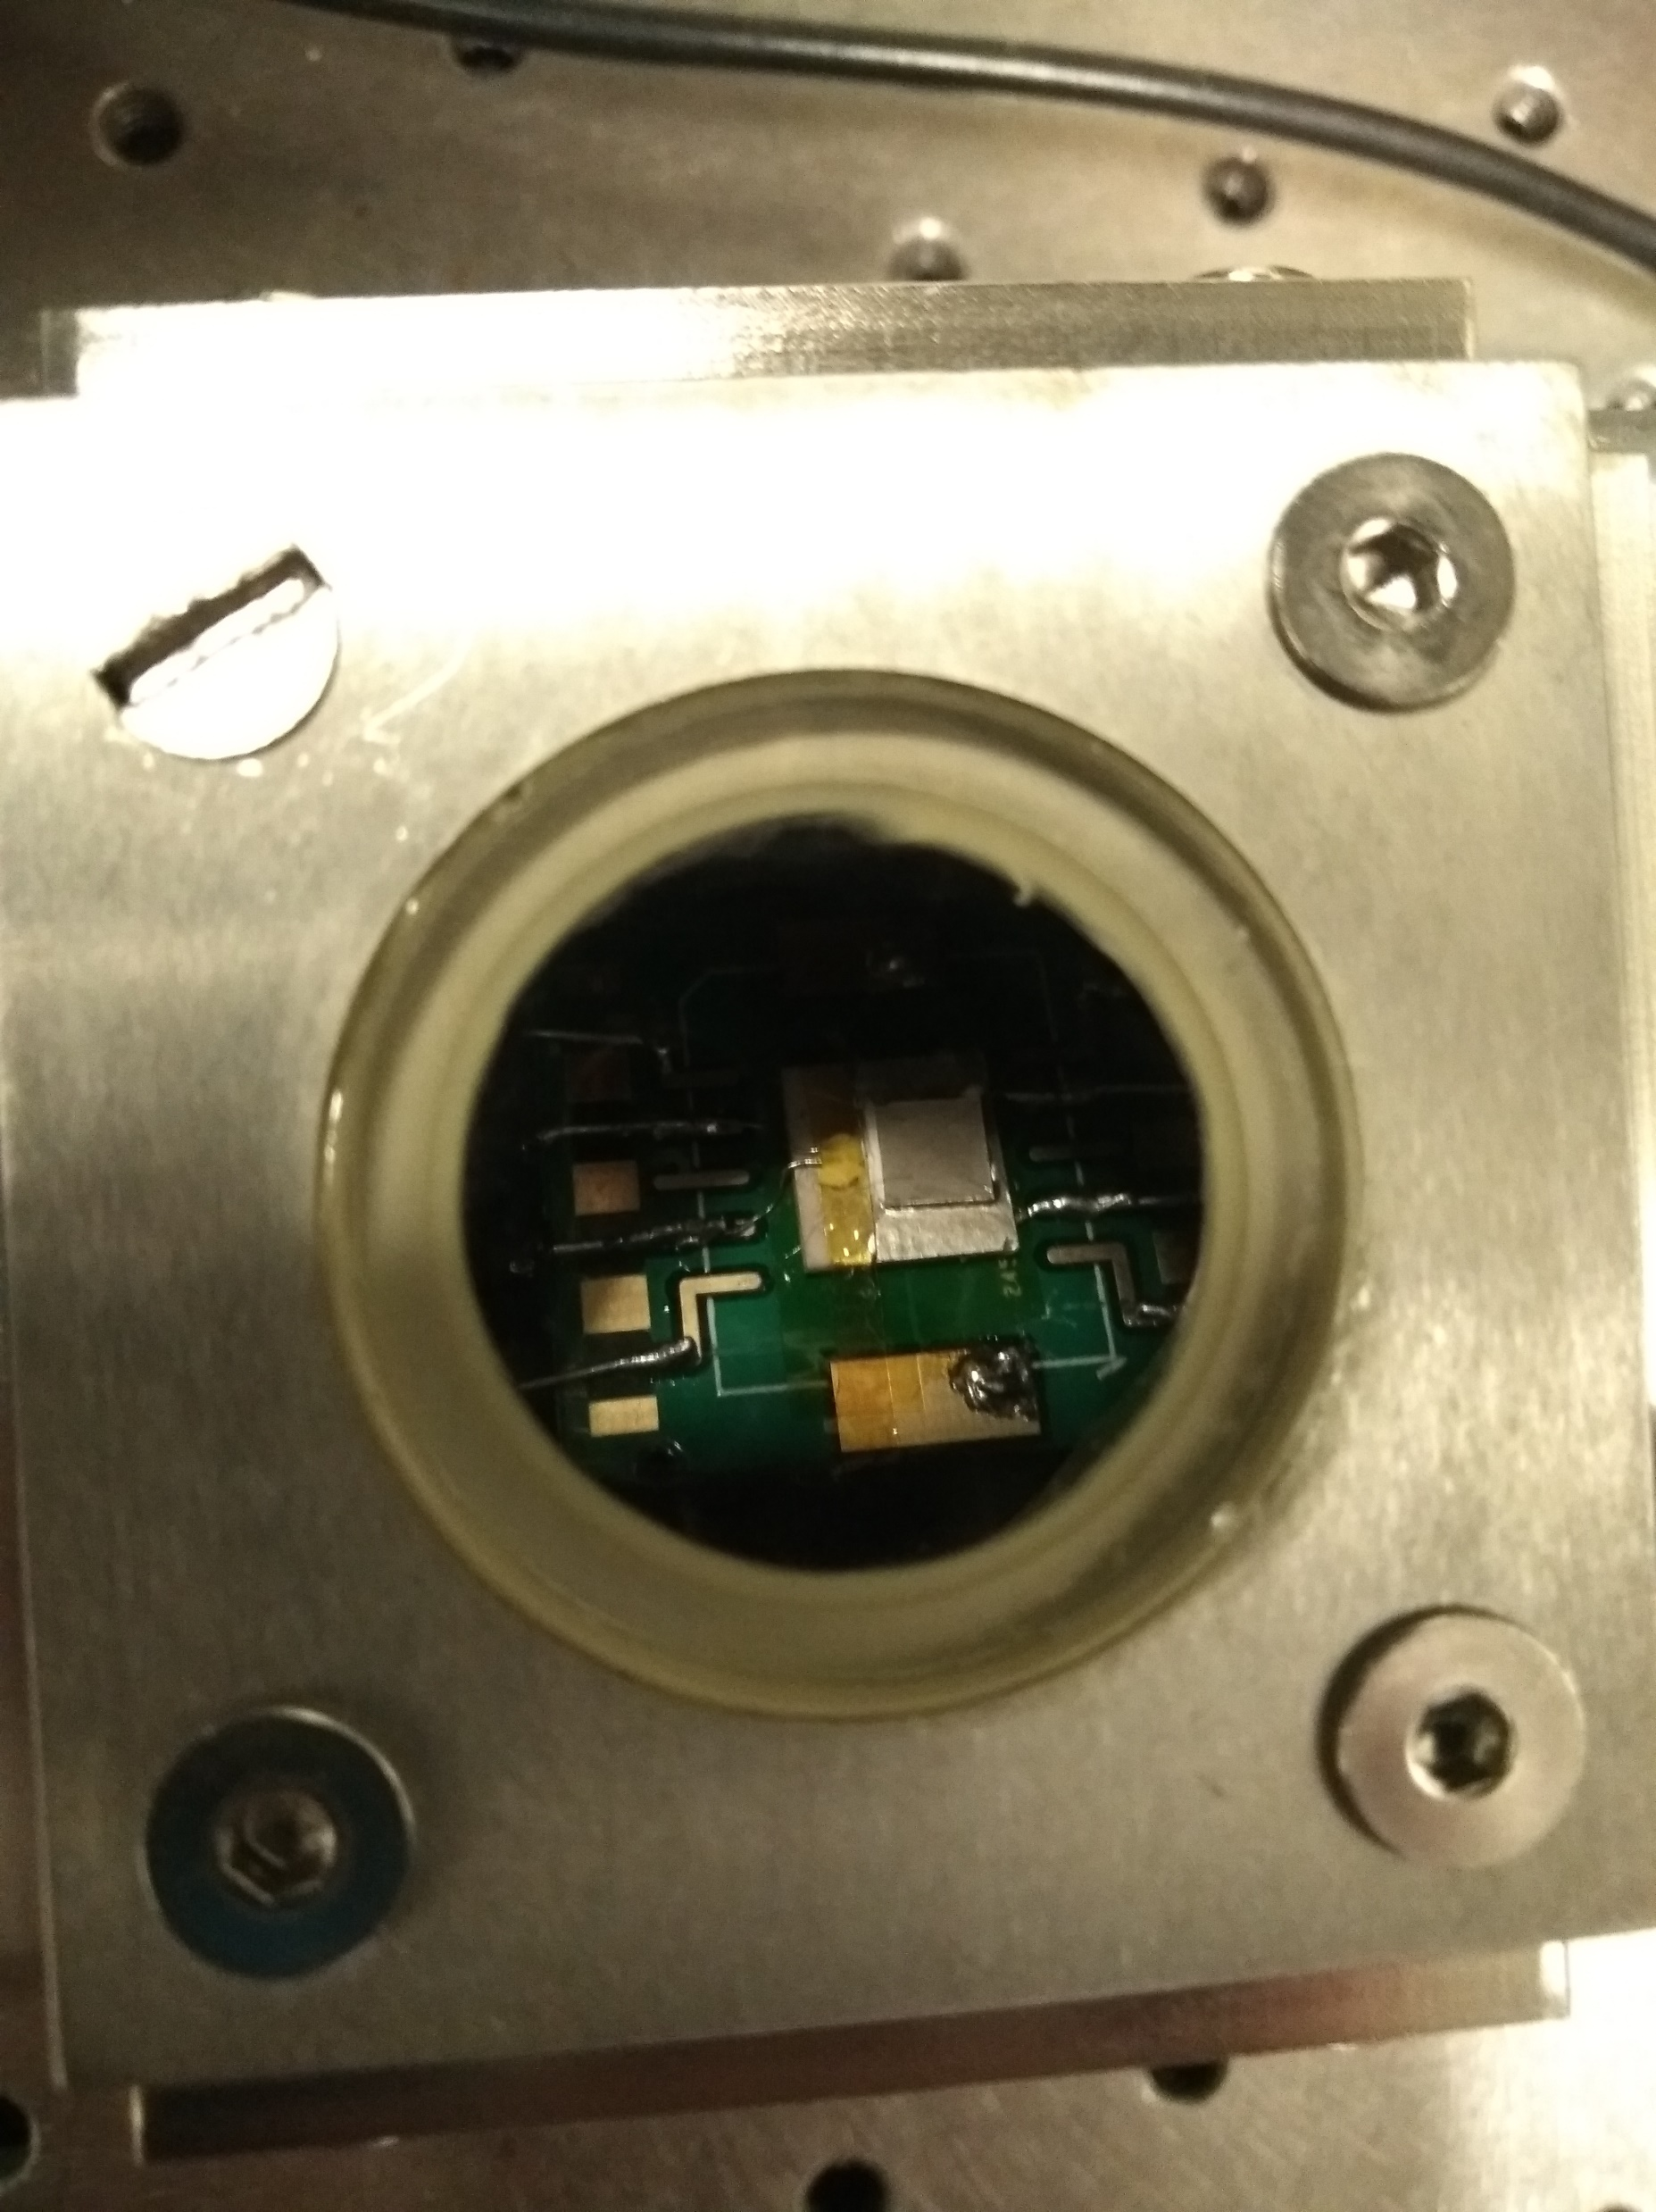
Light (with window)
Kinks at 1.5E-7 A and 1.5 V
Fit results
Name | Measurement | Direction | Position | R (Ohm) | R Std (Ohm)
0117_1703_WO3196_full_IV_curve | Light 25 | Minus | Bottom | 2.29E+07 | 1.48E+05
0117_1703_WO3196_full_IV_curve | Light 25 | Minus | Middle | 1.02E+07 | 5.69E+03
0117_1703_WO3196_full_IV_curve | Light 25 | Minus | Top | 2.35E+07 | 4.31E+04
0117_1703_WO3196_full_IV_curve | Light 25 | Plus | Bottom | 2.15E+07 | 1.09E+05
0117_1703_WO3196_full_IV_curve | Light 25 | Plus | Middle | 1.02E+07 | 1.99E+04
0117_1703_WO3196_full_IV_curve | Light 25 | Plus | Top | 2.39E+07 | 1.53E+05

Slide 4
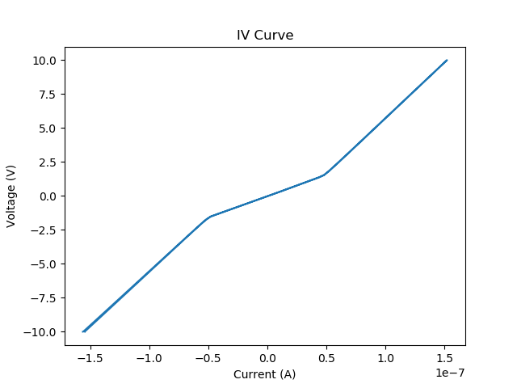
Dark 25 C
Also kinks at 1.5 V and 0.5e-7 A
Fit results
Name | Measurement | Direction | Position | R (Ohm) | R Std (Ohm)
0124_1816_WO3196_full_IV_curve_dark | Dark 25 | Minus | Bottom | 8.05E+07 | 2.78E+04
0124_1816_WO3196_full_IV_curve_dark | Dark 25 | Minus | Middle | 3.16E+07 | 8.11E+04
0124_1816_WO3196_full_IV_curve_dark | Dark 25 | Minus | Top | 8.19E+07 | 2.46E+04
0124_1816_WO3196_full_IV_curve_dark | Dark 25 | Plus | Bottom | 7.96E+07 | 3.31E+04
0124_1816_WO3196_full_IV_curve_dark | Dark 25 | Plus | Middle | 3.14E+07 | 7.42E+04
0124_1816_WO3196_full_IV_curve_dark | Dark 25 | Plus | Top | 8.21E+07 | 3.58E+04

Slide 5
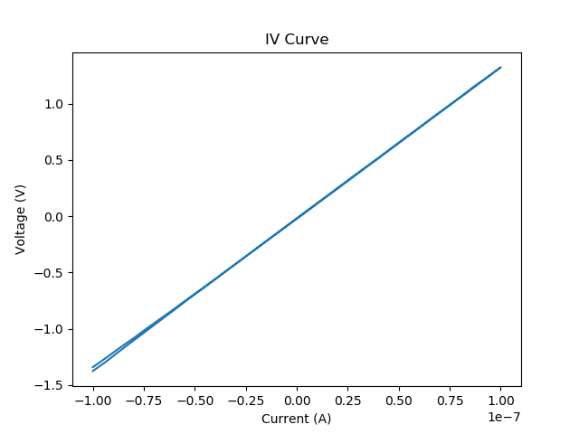
Dark 65 C
No kinks at all
Fit results
Name | Measurement | Direction | Position | R (Ohm) | R Std (Ohm)
0127_1527_WO3196_full_IV_curve_dark | Dark 65 | Minus | All | 1.35E+07 | 8.73E+03
0127_1527_WO3196_full_IV_curve_dark | Dark 65 | Plus | All | 1.33E+07 | 1.47E+04

Slide 6
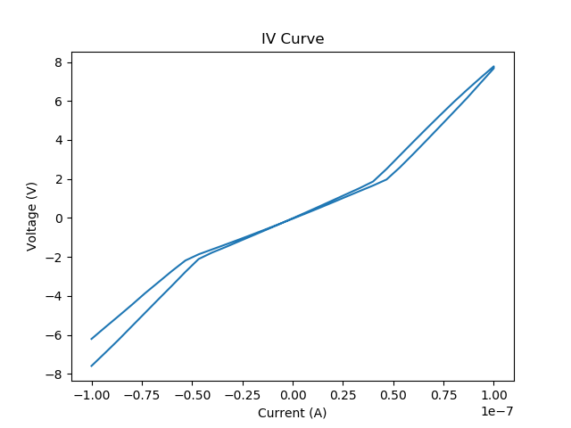
H2 Dark
Kink also at 1.5 V
Resistance was changing over time, therefore the plus and minus curves are different
Fit results
Name | Measurement | Direction | Position | R (Ohm) | R Std (Ohm)
0127_1854_WO3196_full_IV_curve_h2_100nA | H2 25 | Minus | Bottom | 1.04E+08 | 4.19E+05
0127_1854_WO3196_full_IV_curve_h2_100nA | H2 25 | Minus | Middle | 4.55E+07 | 2.65E+05
0127_1854_WO3196_full_IV_curve_h2_100nA | H2 25 | Minus | Top | 9.95E+07 | 8.71E+05
0127_1854_WO3196_full_IV_curve_h2_100nA | H2 25 | Plus | Bottom | 8.67E+07 | 4.57E+05
0127_1854_WO3196_full_IV_curve_h2_100nA | H2 25 | Plus | Middle | 4.08E+07 | 2.89E+05
0127_1854_WO3196_full_IV_curve_h2_100nA | H2 25 | Plus | Top | 1.09E+08 | 7.52E+05

Slide 7
Data
Resistances IV curve light |  |  |  | Top = high voltage, bottom = negative voltage
Name | Measurement | Direction | Position | R (Ohm) | R Std (Ohm)
0117_1703_WO3196_full_IV_curve | Light 25 | Plus | Middle | 1.02E+07 | 1.99E+04
0117_1703_WO3196_full_IV_curve | Light 25 | Plus | Top | 2.39E+07 | 1.53E+05
0117_1703_WO3196_full_IV_curve | Light 25 | Plus | Bottom | 2.15E+07 | 1.09E+05
0117_1703_WO3196_full_IV_curve | Light 25 | Minus | Top | 2.35E+07 | 4.31E+04
0117_1703_WO3196_full_IV_curve | Light 25 | Minus | Bottom | 2.29E+07 | 1.48E+05
0117_1703_WO3196_full_IV_curve | Light 25 | Minus | Middle | 1.02E+07 | 5.69E+03
0124_1816_WO3196_full_IV_curve_dark | Dark 25 | Plus | Middle | 3.14E+07 | 7.42E+04
0124_1816_WO3196_full_IV_curve_dark | Dark 25 | Plus | Top | 8.21E+07 | 3.58E+04
0124_1816_WO3196_full_IV_curve_dark | Dark 25 | Plus | Bottom | 7.96E+07 | 3.31E+04
0124_1816_WO3196_full_IV_curve_dark | Dark 25 | Minus | Bottom | 8.05E+07 | 2.78E+04
0124_1816_WO3196_full_IV_curve_dark | Dark 25 | Minus | Middle | 3.16E+07 | 8.11E+04
0124_1816_WO3196_full_IV_curve_dark | Dark 25 | Minus | Top | 8.19E+07 | 2.46E+04
0127_1527_WO3196_full_IV_curve_dark | Dark 65 | Plus | All | 1.33E+07 | 1.47E+04
0127_1527_WO3196_full_IV_curve_dark | Dark 65 | Minus | All | 1.35E+07 | 8.73E+03
0127_1854_WO3196_full_IV_curve_h2_100nA | H2 25 | Plus | Bottom | 8.67E+07 | 4.57E+05
0127_1854_WO3196_full_IV_curve_h2_100nA | H2 25 | Plus | Middle | 4.08E+07 | 2.89E+05
0127_1854_WO3196_full_IV_curve_h2_100nA | H2 25 | Plus | Top | 1.09E+08 | 7.52E+05
0127_1854_WO3196_full_IV_curve_h2_100nA | H2 25 | Minus | Bottom | 1.04E+08 | 4.19E+05
0127_1854_WO3196_full_IV_curve_h2_100nA | H2 25 | Minus | Middle | 4.55E+07 | 2.65E+05
0127_1854_WO3196_full_IV_curve_h2_100nA | H2 25 | Minus | Top | 9.95E+07 | 8.71E+05

